Slide 1
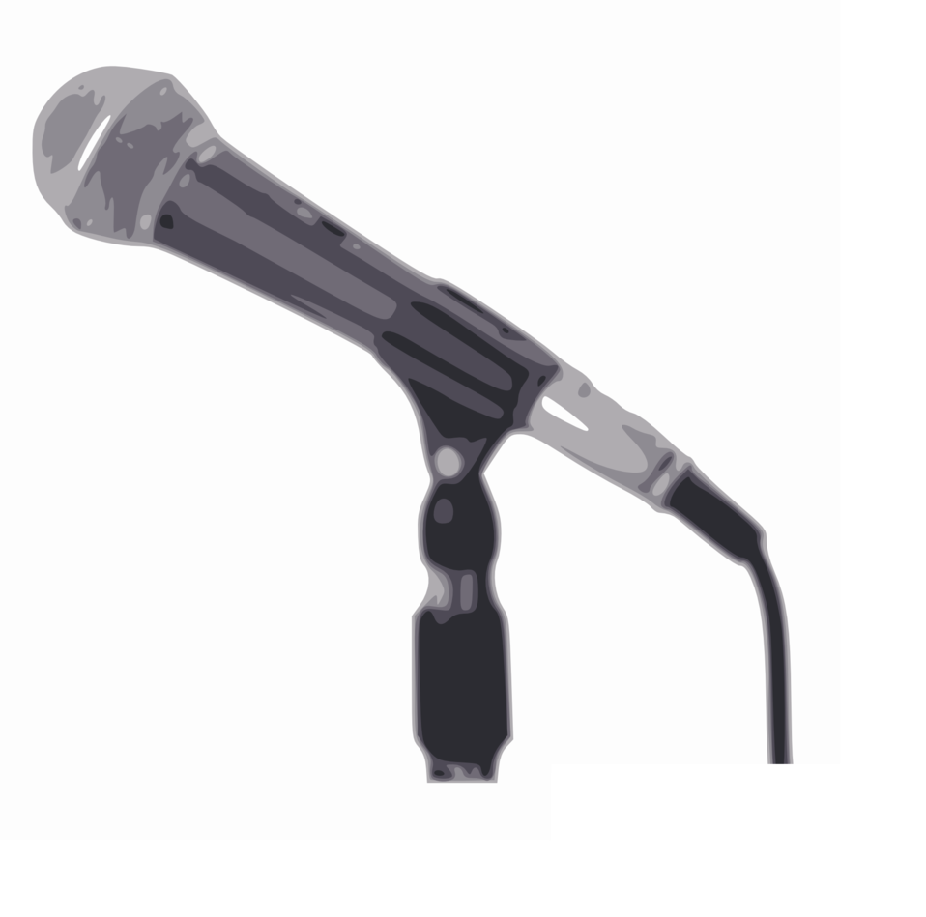
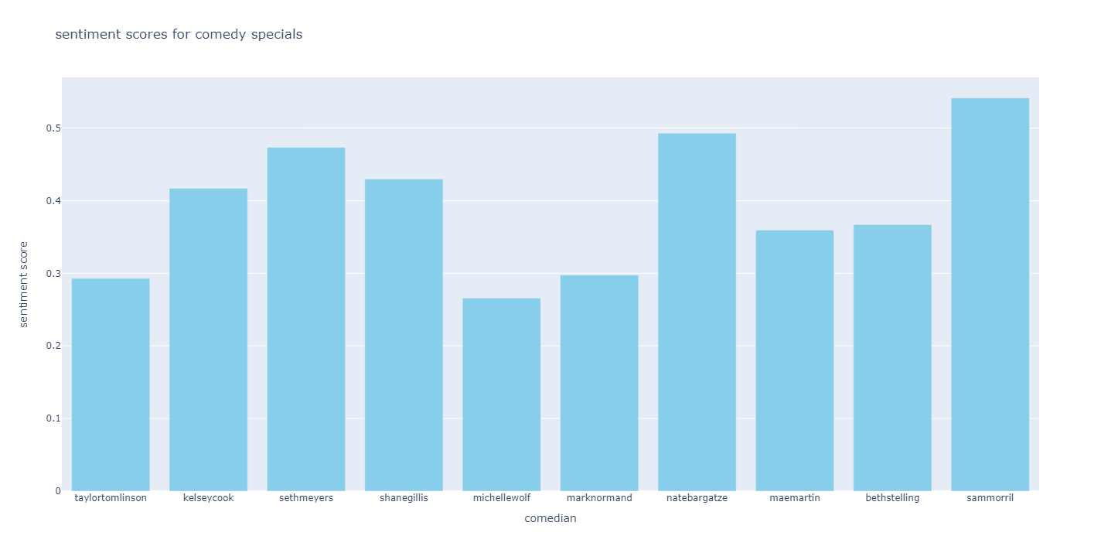
Natural Language Processing - Stand Up Comedy
Sean Ayoub | Professor Rachlin | DS 3500
For this project, I did text analysis on the transcripts from ten different stand-up comedy specials released in the past few years. The goal for this analysis was to investigate which factors in the monologue contribute to more memorable performances.
In the Sankey Diagram, I had to filter out several swear words in order to find the most frequently used words, which didn’t surprise me. The word “know” had 823 total uses and was said by every performer.
Using subplots, I mapped readability score to sentiment score for each special. The general trend is that as the readability improves, so does the sentiment score, which in this case can imply which jokes in the set were the funniest.
Lastly, I created a bar plot showing the average sentiment score for each performance. We see that Sam Morril’s special had the highest score, implying that it was the most “positive” or lighthearted. Michelle Wolf had the lowest score, which might have to do with her political satire, referencing heavy or dark subjects.

